Slide 1
ARTIFICIAL INTELLIGENCE
The Future Of Technology

Slide 2
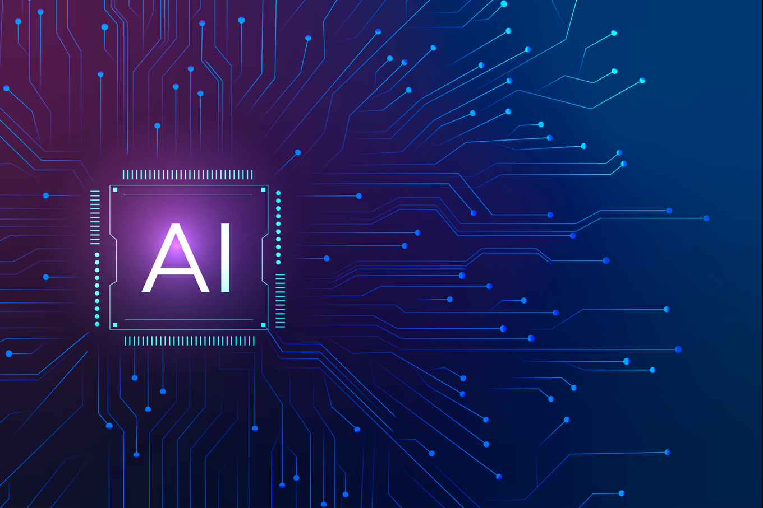
Artificial Intelligence
Machines that can learn, reason and perform tasks.
Used across business, science and everyday life.
Rapidly changing how people work and communicate.

Slide 3
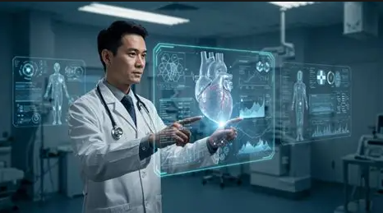
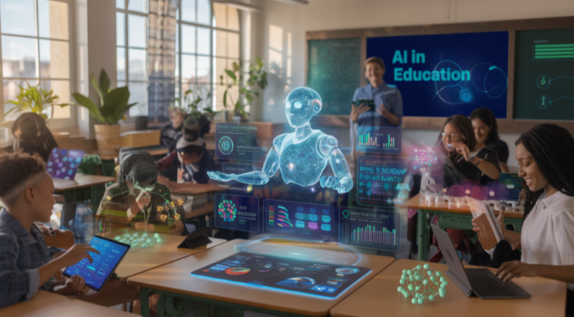
Applications of AI
Healthcare: medical imaging and decision support.
Education: personalized learning.
Banking: fraud detection and risk analysis.
Transportation: navigation and driver assistance.

Slide 4
AI Applications by Sector
Sector | Share
Healthcare | 25%
Education | 20%
Banking | 30%
Transport | 25%

Slide 5
Advantages and Disadvantages
Advantages | Disadvantages
Automation | Job Displacement
Faster Decisions | Privacy Concerns
Improved Accuracy | High Implementation Cost

Slide 6
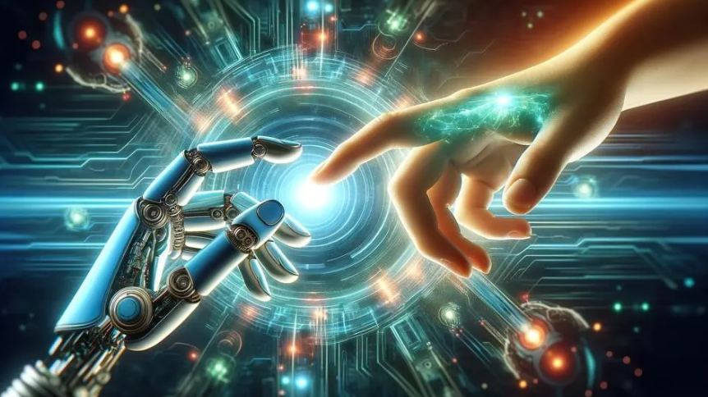
Conclusion
AI can automate repetitive work and support better decisions.
Its benefits depend on responsible design and human oversight.
Learning AI skills can create opportunities across many industries.

